Slide 1
CHAPTER 9
Functions

Slide 2
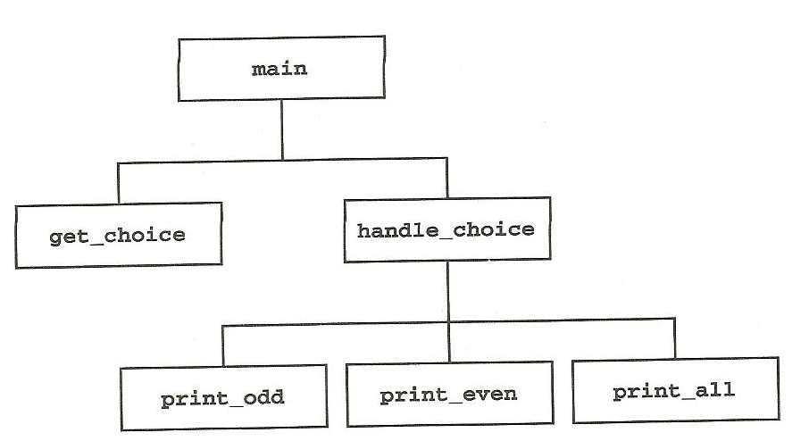
Functions divide a program into specific tasks.
Things to consider when creating a function
Organization – A well organized program containing multiple functions is easier to debug.
Autonomy – The function does not depend on code outside of it any more than necessary.
Encapsulation – Enclosing details of a function within itself, so specific details don’t need to be known in order to use it.
Reusability – So the function can be applicable for multiple uses in a program.

Slide 3
Note: There are two popular methods of designing programs. A top-down design puts functions at the top of your code, and functions are written before other parts of the program are written. A bottom-up design is the opposite, in which you work going up through your code. Some programmers use this to work out specifics and details first, and bring the overall organization and flow together later.
The basic syntax of functions can be seen in one we already used - int main().
Ex.
int main()
{
//body of program
return 0;
}
The return 0; returns the value of 0 to the operating system, to tell that the program ran normally.
This return statement can return values in other functions. As you will see later.

Slide 4
A function that returns nothing can be declared as a void.
Ex.
Void print_title()
{
cout << “Ping Pong Tournament Scheduler Program”
}
A function like this can be called upon in the main to perform the code it contains.
Ex.
int main()
{
print_title(); //calling function return 0;
}
The calling function calls the above void print_title, which was placed outside the main. Once reached, the code within print_title will be executed.

Slide 5
Functions must be declared at the top of the program as well. This is called the function prototype.
Ex.
void print_title(); //prototype
int main()
{
print_title(); //calling upon function
return 0;
}
void print_title() //actual function
{
cout << “Ping Pong Tournament Scheduler Program”
}

Slide 6
So far we’ve only been declaring variables in the main().
These variables would be inaccessible outside the main. The availability of a variable is called the scope.
There are two types of variables. Global Variables and Local Variables.
Local Variables can only be accessed inside of one function.
Global Variables are accessible by any function.
Ex.
#include <iostream>
int i = 3; //global variable
void myfunction();
int main()
{
int j; //local variable
return 0;
}
void myfunction()
{
int k; //local variable
}

Slide 7
Though global variables can be used in every function, they should be kept to a minimal, as it is easier to maintain and debug code that uses local variables more often.
Local variables can be passed in functions to use them between different functions. This is done in the argument, the parenthesis after a function.
When you are passing by value, a copy of they value of the variable is given to the function to use. If it is changed within the function, the original copy of the variable in the calling function remains the same.
Ex.
void print_true_or_false(int True_False)
In this statement, the True_False variable is called a parameter.
Note: Arguments and parameters are actually different. An argument is a value or expression passed through the parenthesis when a function is called. A parameter is the variable that receives the value or any other identifier in the parenthesis of the function declaration. Basically, and argument is passed to a function, but once in the function, it is a parameter.

Slide 8
When you write a function, you can put any variable of literal in the parenthesis to be passed, as long as the data types don’t conflict.
Ex.
print_true_or_false(complete); //passes a variable
print_true_or_false(1); //passes a literal
print_true_or_false(j == 3 && k == 2); //passes result of
an expression
The variable name in two functions don’t have to correspond. Just the data types.
Ex.
#include<iostream>
void print_value(int j);
int main()
{
int i = 2;
cout << “before function” << i;
print_value(i);
cout << “after function” << i; // will output a 4.
return 0;
}
void print_value(int j) // notice how the variable name can be different
{
j = j * 2;
}

Slide 9
Passing by reference will pass any changes made to the variable back to the calling function.
Ex.
void get_values(float &income, float &expense)
{
cout << “Enter income amount”;
cin >> income;
cout << “Enter expenses amount”;
cin >> expense;
}
To pass by reference, just put an ampersand(&) in front of the variable.
Passing by reference should be used more sparingly than passing by value.
Only pass by reference when data needs to be passed back to the calling function.

Slide 10
Passing by address is used for passing arrays (such as character arrays).
Syntax looks like passing by value, but it is not.
Passing by address finds the first element of the array in the memory to use it.
So, any changes made to the array in a function remains that way and these changes carry back to the call function.

Slide 11
Remember the return keyword?
Any function not declared with void will return a value to the call function.
This is specified using a return statement.
Ex.
float celcius_to_fahrenheit(float c)
{
float f;
f = c * (9.0/5.0) + 32.0;
return(f);
}
Since it is returning a float, the function is declared as float.
Also can be returned as:
float celcius_to_fahrenheit(float c)
{
return(c * (9.0/5.0) + 32.0);
}

Slide 12
Functions that already come with your compiler are called library functions.
These are provided with the #include compiler directives.
Ex.
double pow(double x, double y);
This is and example of the pow() function, which raises numbers to a power. Used to put x to the y power.
Ex.
x_to_the_y = pow(x,y);
It is put in the compiler by including the header file math.h.
Ex.
#include<math.h>
More library functions in C++ are listed on pg. 171-172.

Slide 13
Key Terms
argument
bottom-up design
encapsulation
external variable
global variable
header file
library functions
local variables
parameter
pass
passing by address
passing by reference
passing by value
prototype
scope
top-down design

